Slide 1
Instructions
Step 1: File/Save a new copy of the file for your Project.
Step 2: Inserting image onto page
  Right click on the image box
  Click “Change Picture” and navigate to desired image
  Formatting size of image boxes use 18.5cm for the height, width will vary.
Step 3: Create Legend
  If shapes or symbols are used, include them in the legend with a description of their meaning
  Differentiate workspace or items by colour
Step 4: Replace highlighted text underneath images
Step 5: If applicable, bring north arrow to front of image by right clicking and selecting “bring to front”
Step 6: Insert additional slides
  Click “New Slide” on the tool bar
  Click “Duplicate Selected Slide”
Step 7: Once complete, PDF document by selecting: File – Save as Adobe PDF and submit with Proposal

Slide 2
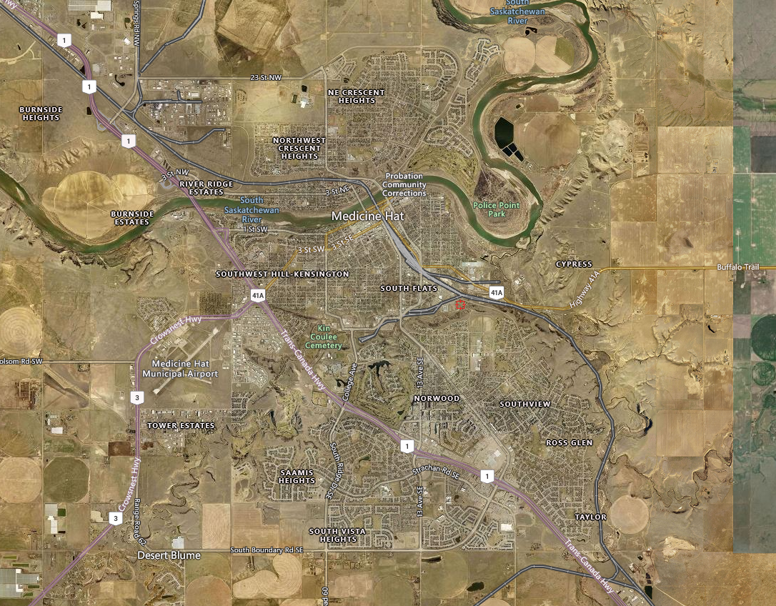


Legend:
Extent of Workspace
Work Location
Enter Proposal Name
Enter Figure Name
Date:
Assumptions:
Figure:
Date
Name of Proposal
2

Slide 3
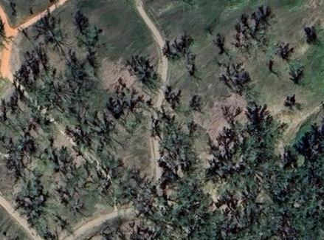
Legend:
Extent of Workspace
Project Entrance and Muster Point
Enter Proposal Name
Enter Figure Name
Date:
Assumptions:
Figure:
Date
Name of Proposal
3

Slide 4
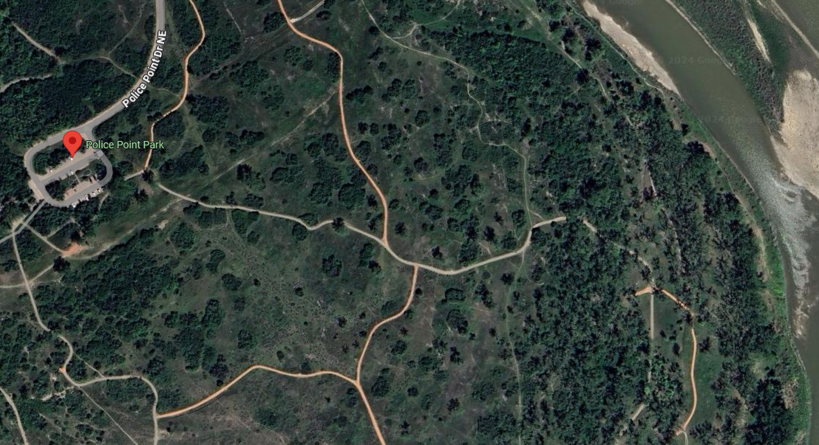
Legend:
Route to Acces
Project Location
Enter Proposal Name
Enter Figure Name
Date:
Assumptions:
Figure:
Date
Name of Proposal
4

