Slide 1
Step 1: File/Save a new copy of the file for your Project.
Step 2: Change text on the header of the slide by editing in the Master slide.
  Click “View” on the tool bar
  Click “Slide Master”
  Edit text accordingly
  Click “Close Master View”
Step 3: Inserting project photographs
  Right click on the image box
  Click “Change Picture” and navigate to desired image
  Insert images in chronological order – Ex. View of area, north, east, south, west.
  Formatting size of image boxes use 8.80cm for the height, width will vary.
Step 4: Replace highlighted text underneath images
  Insert text with description of the picture and direction of which the picture was taken.
    Ex. Main entrance of the project area; view: North
Step 5: Insert additional slides
  Click “New Slide” on the tool bar
  Click “Duplicate Selected Slide”
Step 6: Delete this slide.
Step 7: Once complete, PDF document by selecting: File – Save as Adobe PDF and submit with Proposal​

Slide 2
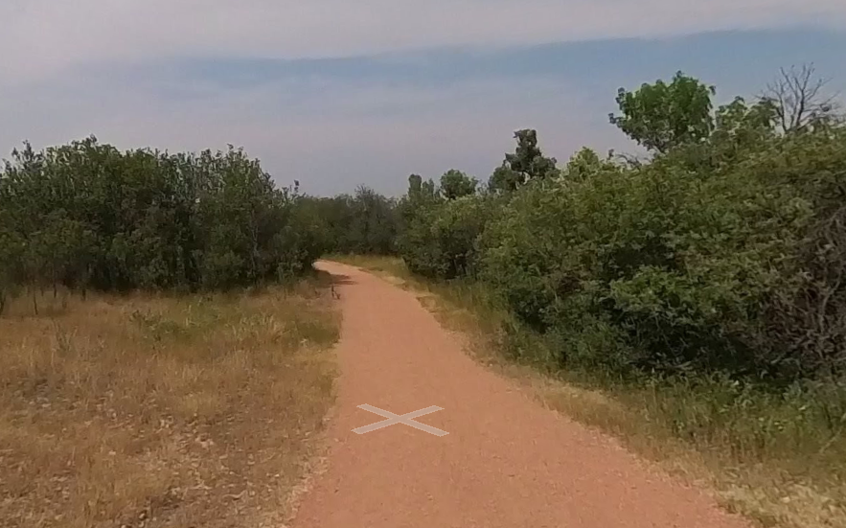
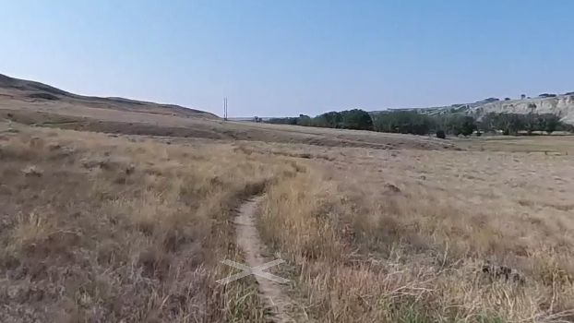
1. Provide a description of the picture; insert the direction of which the picture was taken
Example: Viewing north along path within proposed Project extents, workspace located to the left of the path. Scope involves rehabilitation/restoration of native plant species.
Provide a description of the picture; insert the direction of which the picture was taken
Example: Viewing south towards South Saskatchewan River and proposed Project
extents, desire line path visible in foreground. Scope involves mechanical removal of Euphorbia esula.

